Slide 1
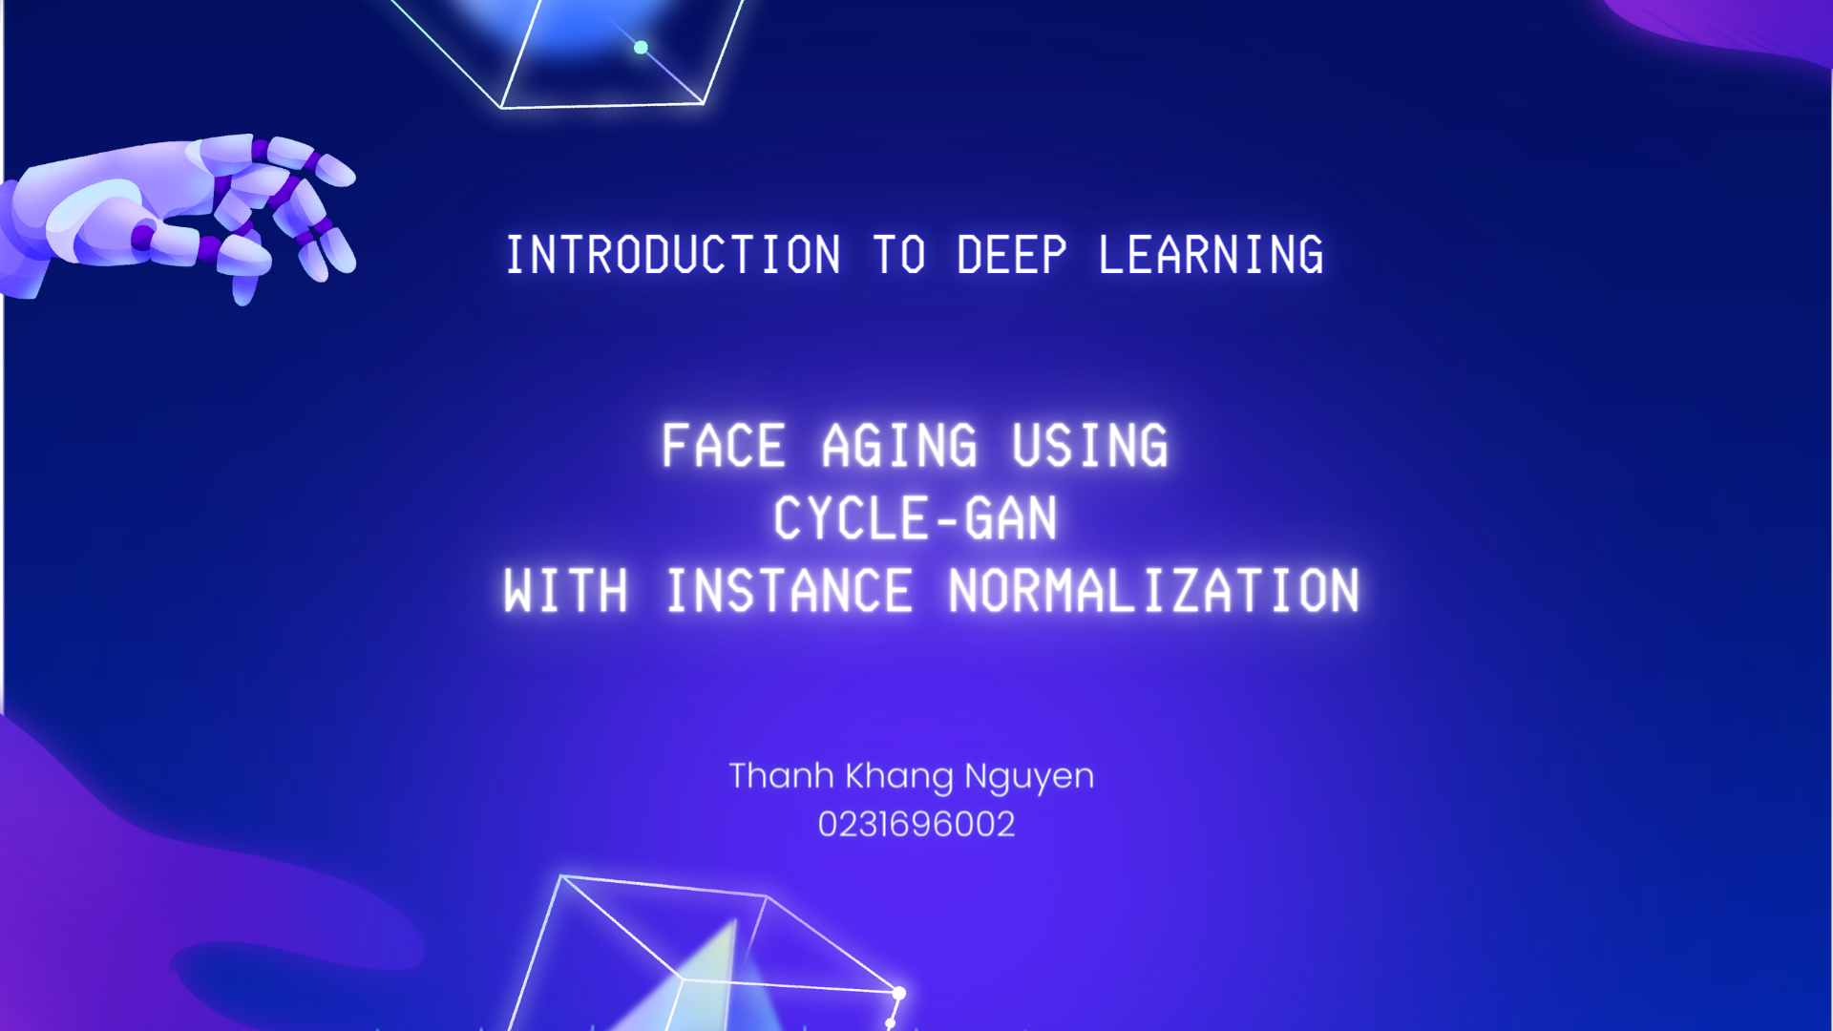

Slide 2
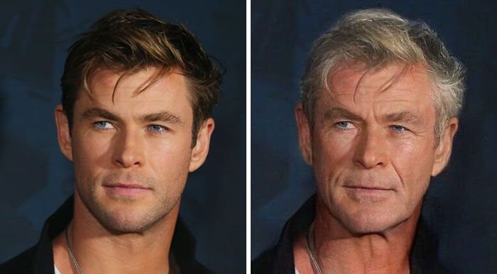
Introduction
Project Aim: Implement CycleGAN model with Instance Normalization for face aging.
Objective: Convert images between young and old age groups using the UTKFace dataset.
Many practical applications: entertainment, cosmetics, digital forensics.
.

Slide 3
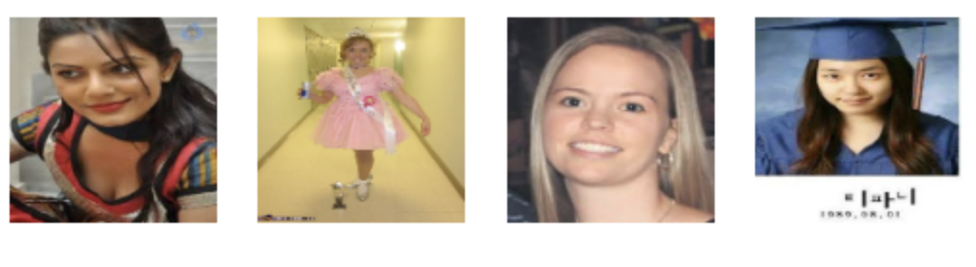

Dataset
Source: UTK Face dataset.
Composition: Over 20,000 facial images with age, gender, and ethnicity annotations.
Age Groups: Young (18-25 years) and Old (49-60 years).
Preprocessing:
- Images resized to 128x128 pixels.
- Normalized pixel values.
- Subsampled for training efficiency.
Batch A: 18-25 years old
Batch B: 49-60 years old

Slide 4
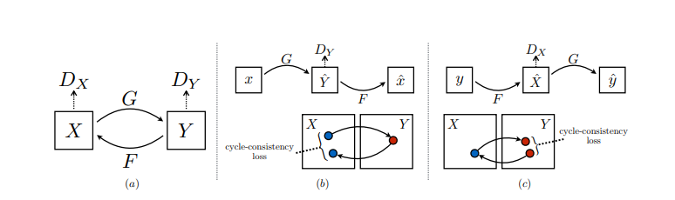
Methodology: Introduction to CycleGAN
Unlike traditional GANs, CycleGAN can learn to translate images between two domains without needing paired examples.
Illustrates the cycle consistency loss
Illustrates the cycle consistency loss
Generators (G and F):
G maps images from domain X to domain Y.
F maps images from domain Y to domain X
Discriminator (Dx and Dy):
Dx: distinguishes between real and generated images in domain X
The total loss function for CycleGAN is a weighted sum of these three losses: Adversarial Loss, Cycle Consistency Loss, Identity Loss

Slide 5
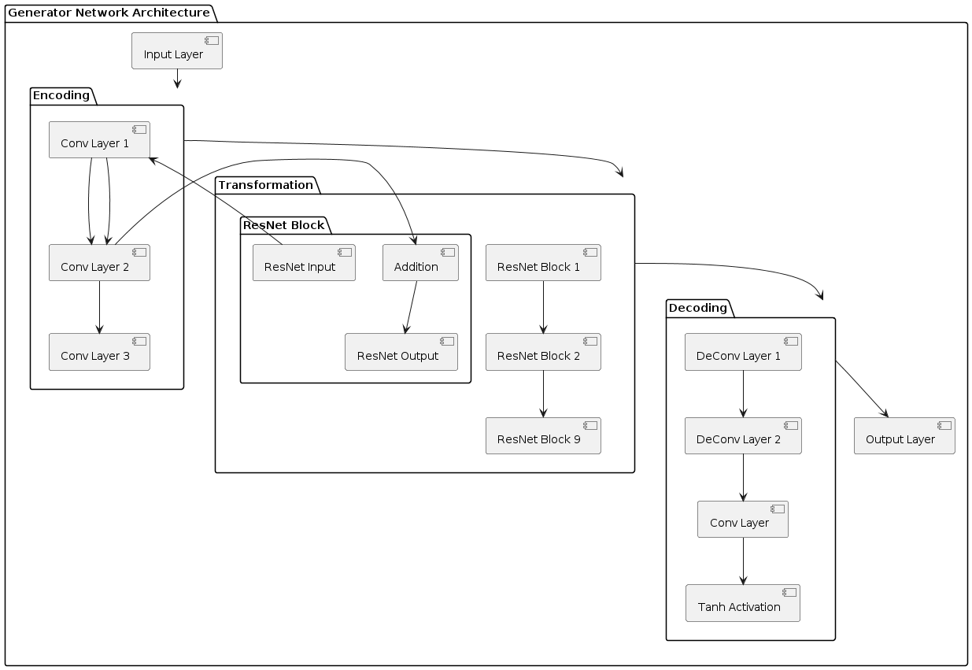
Methodology: Generator Architecture
Input Layer: The process starts with the input layer where the original image is fed into the network.
Feature Extraction: Through the encoding layers, the network extracts significant features, applying instance normalization after each convolutional layer.
Transformation: The ResNet blocks transform these features, with instance normalization ensuring consistent output quality.
Upsampling: The decoding layers upsample these transformed features back to the image form, with instance normalization maintaining image quality.
Output Layer: Finally, the output layer produces the aged or rejuvenated image.

Slide 6
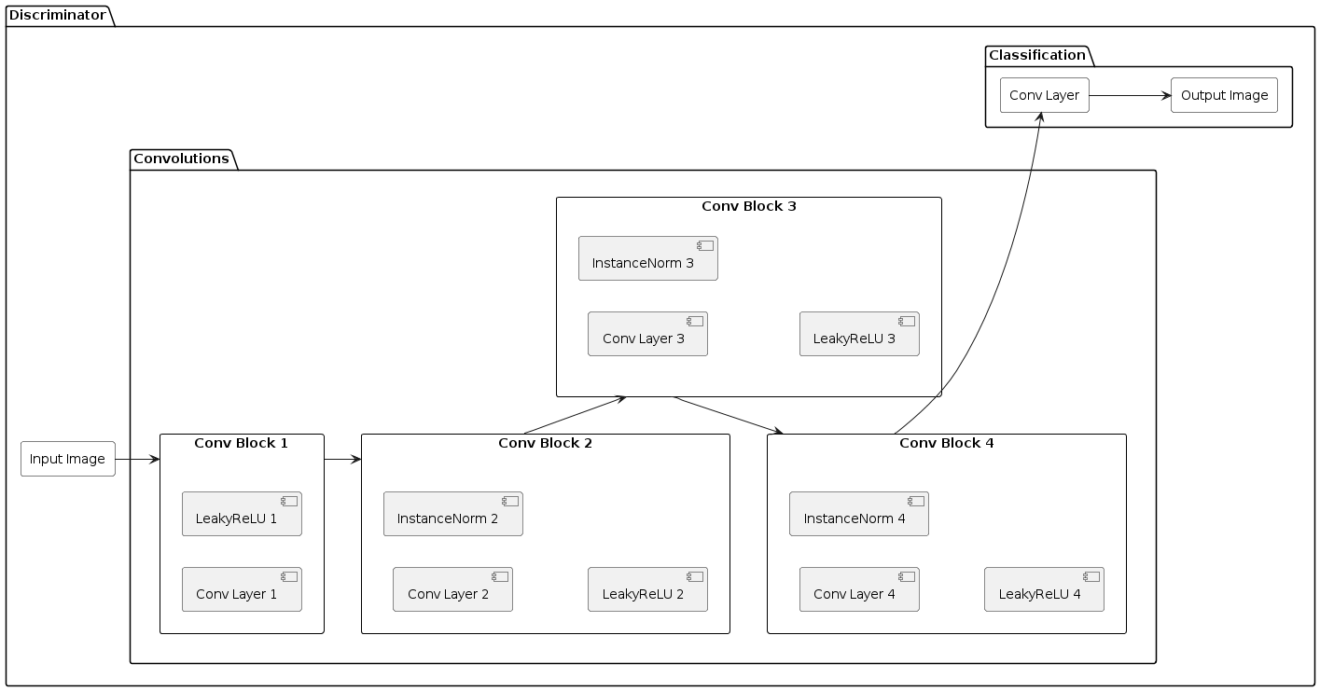
Methodology: Discriminator Architecture
Input Layer: The process starts with the input layer where the image (either real or generated) is fed into the network.
Feature Extraction: Through the convolutional layers, the network extracts significant features, applying instance normalization and leaky ReLU activation after each layer.
Patch Classification: The PatchGAN architecture allows the network to classify each patch of the image, focusing on fine details.
Output Layer: The final output is a matrix of probabilities indicating the likelihood of each patch being real.

Slide 7
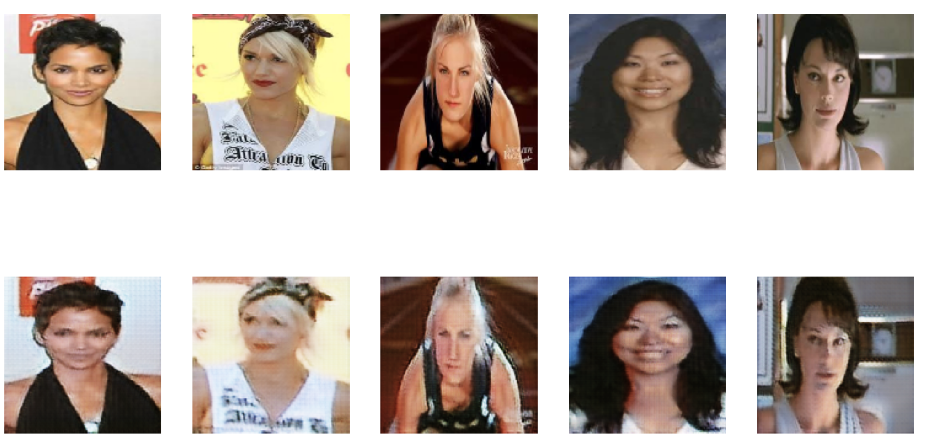
Results - Qualitative: Young to Old

Slide 8
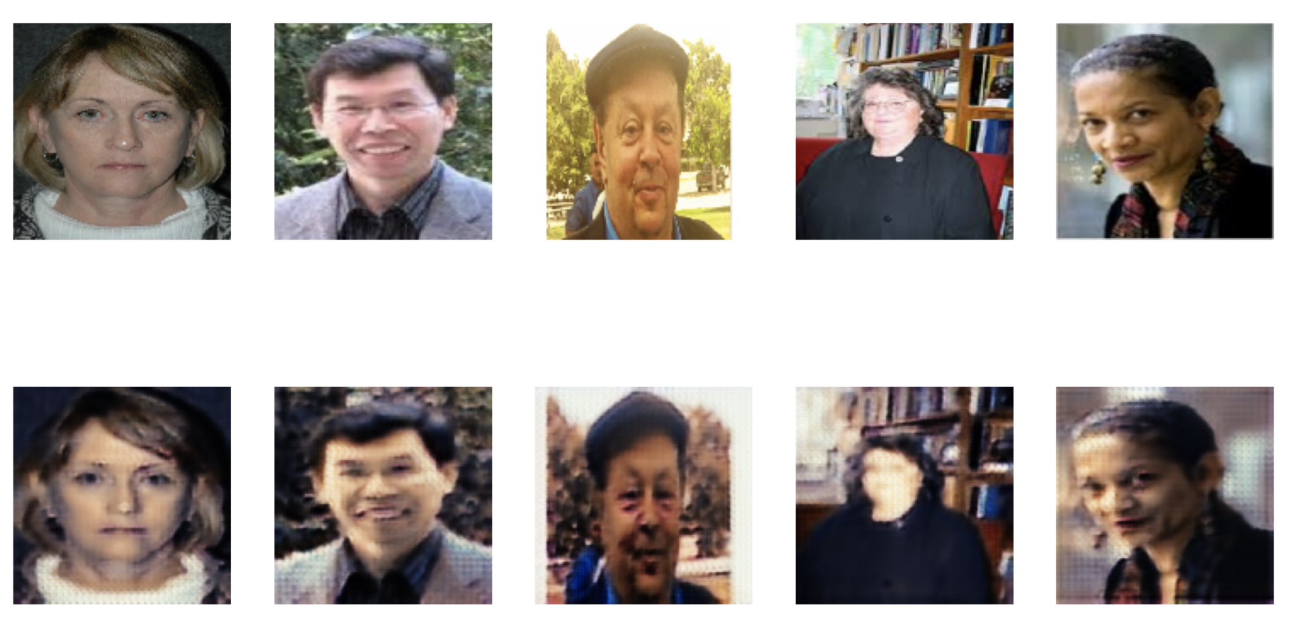
Results - Qualitative: Old to Young

Slide 9
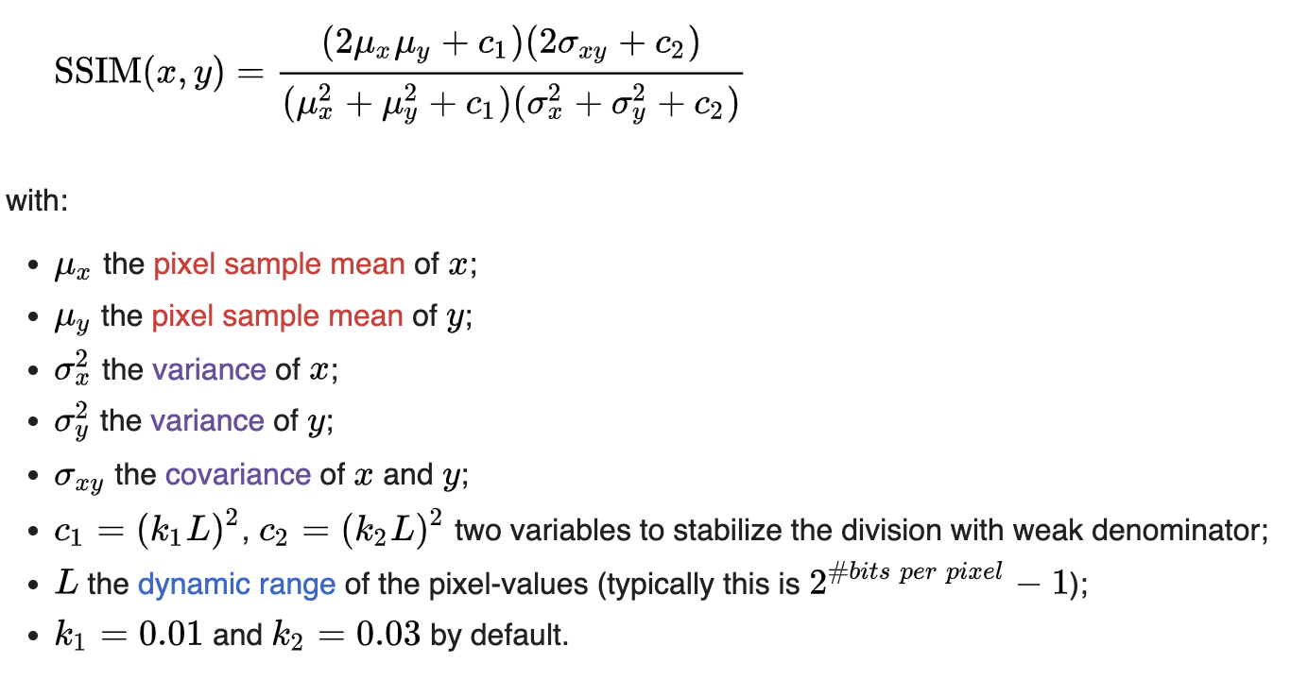
Results - Quantitative
Structural Similarity Index (SSIM):
Measure of image quality based on structural information.
Higher scores indicate better similarity to original images.
Scores:
Average SSIM (Young to Old): 0.6793
Average SSIM (Old to Young): 0.6066
Interpretation:
Higher SSIM for young to old transformation.
Room for improvement in image clarity and reduction of artifacts.

Slide 10
Limitations and Future Works
Training Duration: Limited to 100 epochs due to time constraints. Potential for improved performance with more training.
Image Resolution: Resize to 128x128 pixels. Higher resolution images could improve detail and realism.
Artifacts: Presence of artifacts in generated images. Need for enhancements in architecture or training techniques.
Age Range: Current age groups (18-25 and 49-60) may result in subtle changes. Testing with a broader age range could yield more noticeable transformations.
Extended Training: Increase number of epochs for better convergence.
Higher Resolution: Use higher resolution images for improved detail.
Model Enhancements: Explore advanced architectures and optimization techniques.
Data Augmentation: Increase diversity and resilience of training data.
Pretrained Models: Fine-tune pretrained models for accelerated training.

Slide 11


